Slide 1

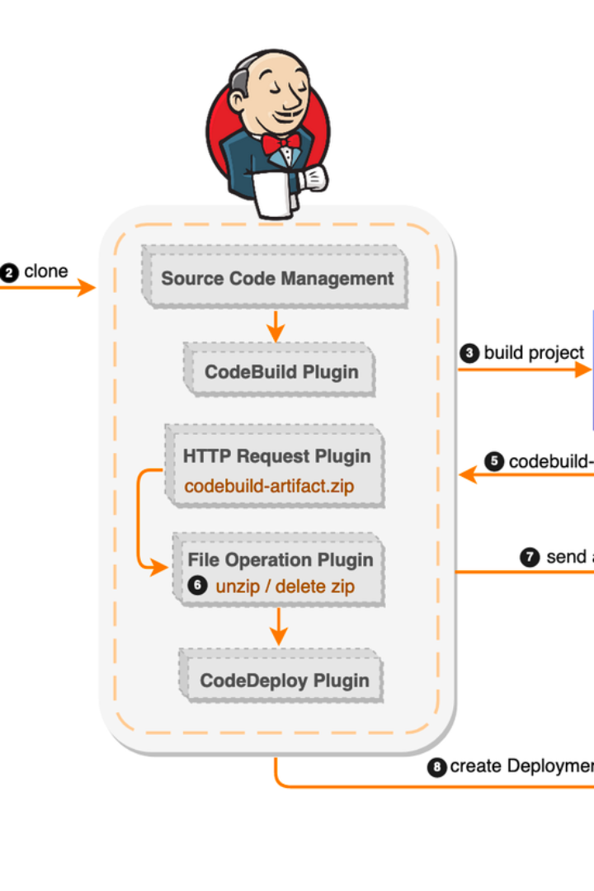

Jenkins CI/CD for IT Professionals
Jenkins is a widely-used open-source automation server that enables continuous integration and continuous delivery (CI/CD) of code. It facilitates the building, testing, and deployment of applications, making the development process more efficient and reliable.
B
by Bathina Siva Prasad Reddy

Slide 2
Overview of CI/CD
1
Continuous Integration (CI)
Automates the process of integrating code changes from multiple developers into a single software project.
2
Continuous Delivery (CD)
Automatically prepares code changes for release to production, ensuring that the software can be deployed at any time.

Slide 3
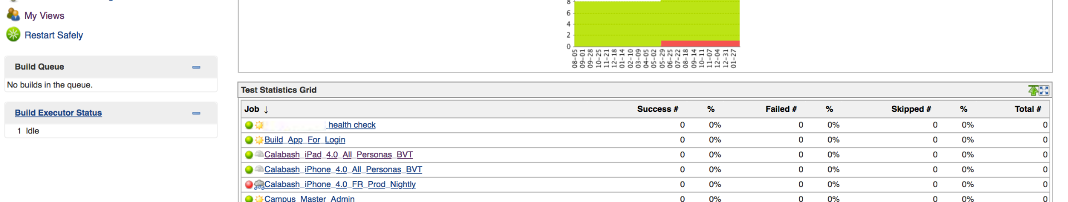
Key Features of Jenkins
Extensibility
Easy Configuration
Scalability
Jenkins offers a vast array of plugins to support building, deploying, and automating any project.
Its web interface allows for easy setup and configuration, reducing administrative overhead.
Jenkins can distribute work across multiple machines, making it scalable for any size project.

Slide 4

Implementing Jenkins on Azure
1
Integration with Azure Pipelines
2
Resource Optimization
Utilize Azure resources for running Jenkins agents to execute build and deployment operations.
Jenkins seamlessly integrates with Azure Pipelines, enabling the creation of sophisticated deployment workflows.

Slide 5

Security Considerations
Role-Based Access Control
Plugin Management
Jenkins offers robust access control with role-based strategies to secure sensitive data and functionalities.
Regularly update and monitor Jenkins plugins to mitigate security vulnerabilities and ensure system integrity.

Slide 6
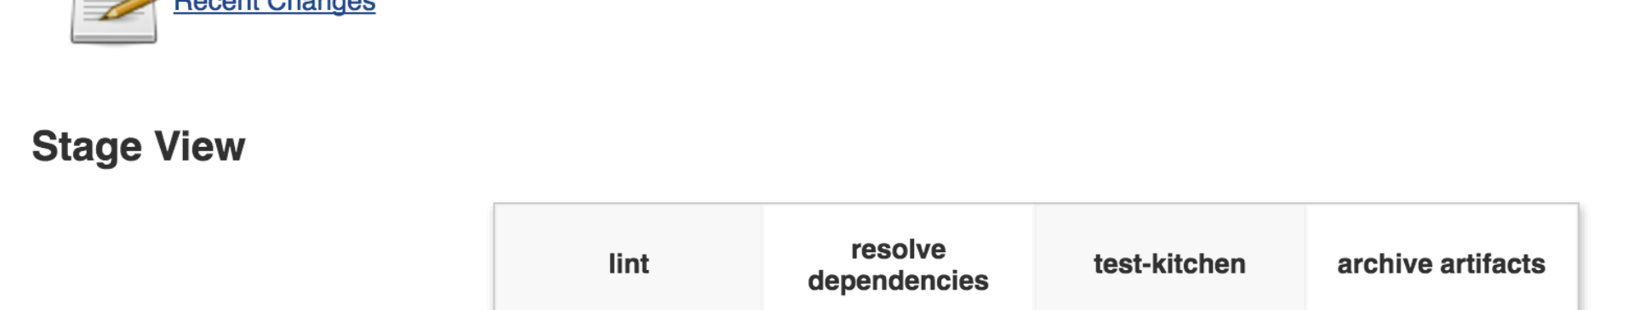


Best Practices
Automate Error Handling
Use Pipeline as Code
Set up automated error handling to ensure that failing builds trigger immediate notifications and actions.
Implementing the defined build process as code provides versioning, testing, and the ability to review changes.

Slide 7
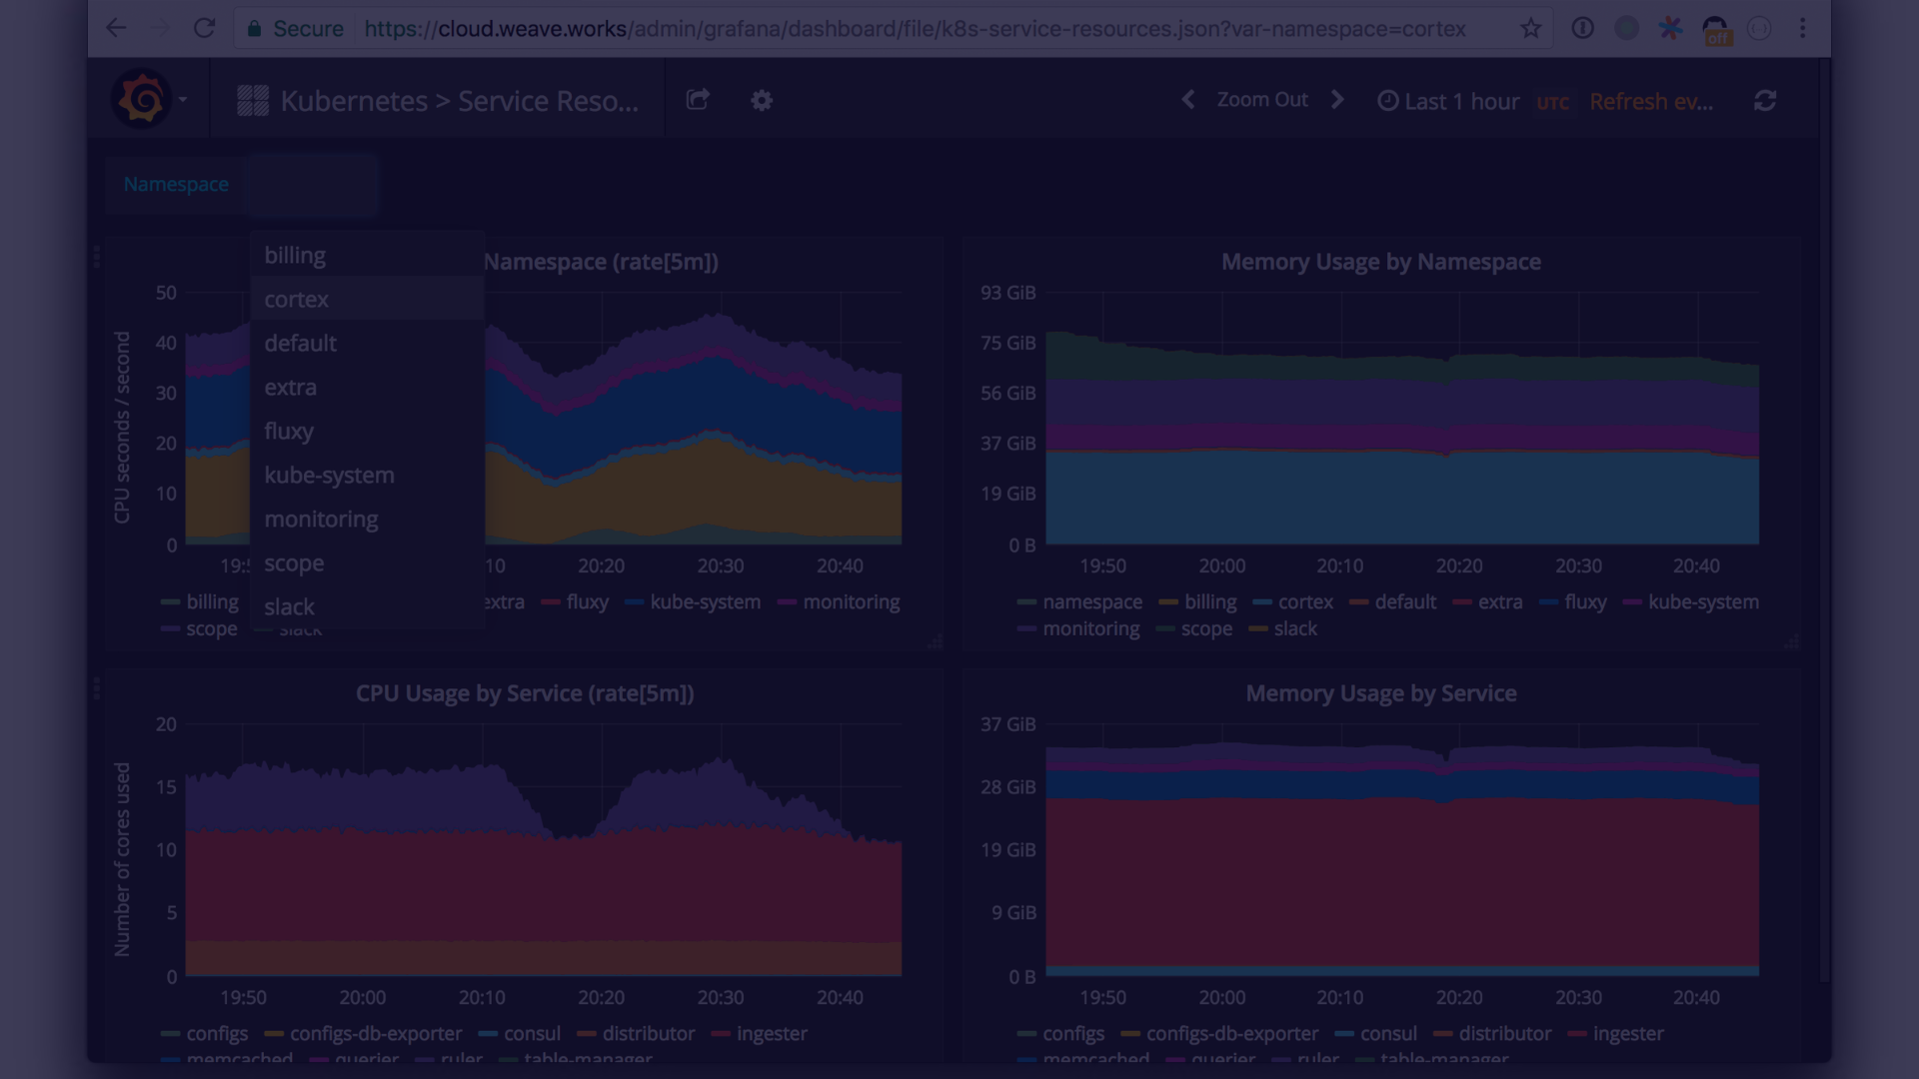
Performance Monitoring and Optimization
1
Metrics and Reporting
2
Resource Allocation
Utilize Jenkins plugins to monitor build performance and generate detailed reports, enabling optimization.
Optimize resource allocation to ensure efficient execution of build and deployment tasks.

Slide 8
Jenkins Pipeline
Stage
Description
Checkout
Retrieve the source code from the self-hosted repository or Azure DevOps.
Build
Compile the source code and execute automated tests.
Deploy
Deploy the application to staging or production environment based on predefined conditions.

Slide 9
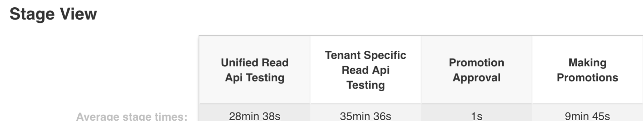
Containerized Deployments with Jenkins
1
Container Orchestration
2
Tagged Images
Jenkins supports orchestrating deployments on popular container platforms like Azure Kubernetes Service.
Automatically tag and publish container images with built-in plugins and Docker integration.

Slide 10
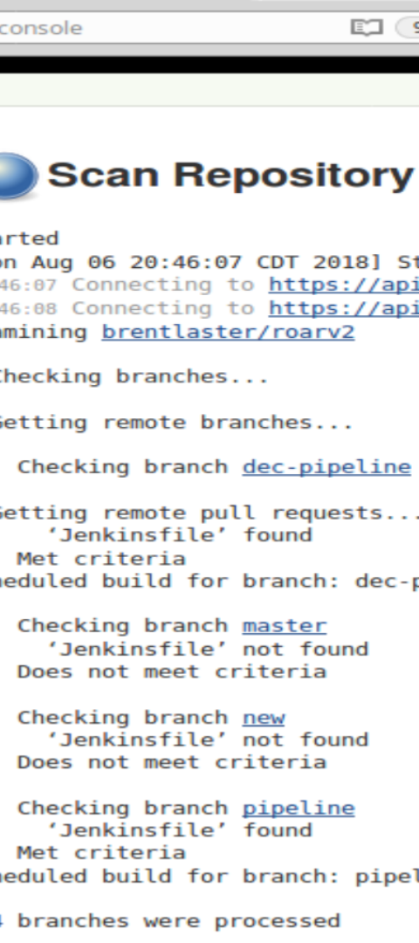


Automating Infrastructure with Jenkins
Infrastructure as Code
Leverage Jenkins to automate the provisioning and scaling of cloud infrastructure using Azure Resource Manager templates.
Continuous Deployment
Automate the deployment of infrastructure changes in sync with the application code deployment process.

